Slide 1
Sustaining Community: Tribal College & University Libraries
Karina Kletscher
Notes:
Hello, my name is Karina Kletscher and I am here to present my findings on Sustaining Community: Supporting Native Students at TCU Libraries. I want to thank the Board for allowing me the time and space to present and discuss approaches.

Slide 2
Brief Statement of Positionality
Notes:
Before diving in, I want to make a brief statement regarding my positionality on this topic. While I am an ally and strong proponent for improving cultural competency, especially concerning Native people, I am a white woman and one who has had to rely on my own research and motivations to become better educated. My research journey has been focused on the research and data done by and for Native people, along with stories and interviews from Native students and educators. However I fully acknowledge that my interpretations of these works may be off due to my outside position. I’m continually learning and look forward to any constructive criticism or recommendations for further works to consult.

Slide 3


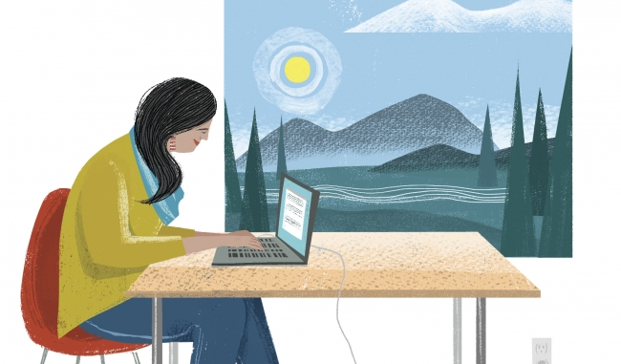
How can we better serve & support our students?
Notes:
We know TCUs are unique and special institutions that enable students to seek affordable higher education without a full disconnect from their heritage; where curriculum is an intersection of cultural values and philosophies with western education standards and practices, which more academic institutions should look to when trying to bridge cultural and academic divides. TCUs are where Native students may be taught by role models who look like them whether these instructors are local elders or AIAN faculty who have pursued advanced degrees themselves. TCUs honor and balance the journey towards skill-building and spiritual growth, while also emphasizing that learning is a lifelong pursuit to seek in education, mentors, and elders ensures that students feel safe and empowered to fulfill their intersectionality as modern, Native students with aspirations. Something we continually ask ourselves is how can we better serve and support our students, particularly in the library?

Slide 4
Our students
Female
Older
American Indian/
Alaska Native
Enrollment increase 2001-2006
23%
First-generation
Students
Notes:
First of all, who are our students? TCUs typically operate on an open charter for admissions, enabling non-American Indian students to attend, promoting and practicing their commitment to diversity and inclusion while remaining true to their values. But the majority of our students identify as American Indian/Alaska Native – which is good considering our criteria is to have a Native majority in the student body. Our students primarily identify as female, in some schools this majority is by only a few percentage points. Our students are more likely to be older – perhaps they waited to decide if college was the path for them or they were saving up for their first few semesters. Our students are also typically first-generation students; they are the first in their families to pursue higher education.

Slide 5
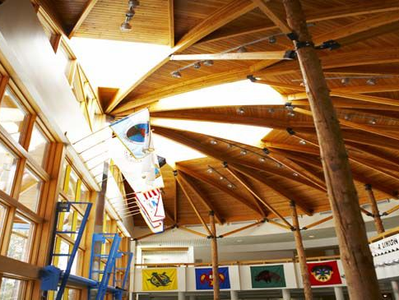

Student
Information Needs
Efficacies
Necessary personal & social skills
Resources
Opportunities
Exist for student success & wellbeing
College & Vocational
Navigating the Acadmy
Social Capital
Informal information sources & support
Academic culture & expectations
Notes:
While our students face similar issues as first-generation students at other colleges and universities, our students are unique in how sociocultural circumstances inform their needs. Many students have little experience with the variety of colleges or career opportunities depending on their exposure to life on or outside of reservations or formal advisement – they may be unaware of college and vocational opportunities available to them now or in the future. Like many other students, understanding and adapting to academic culture and its expectations can be jarring. Higher education includes many other requisites for success such as hard skills like technology literacy and soft skills like information literacy, in addition to procedures and etiquette such as communication with faculty. Navigating the academy is closely linked with developing specific personal and social efficacies. However, depending on home life or cultural values, AIAN students may not have developed features of independence and assertiveness that is tied to navigating higher education’s demands in schedules, workloads, asking for help, or taking credit for one’s work. Our students are (un)intentionally looking to build relationships with like-minded peers here in the schools as well as mentors in faculty and staff who can act as informal information sources and communities of support outside of their families or home communities. Part of this social capital aspect is learning about the campus resources or partnerships that exist purely for student success and wellbeing.

Slide 6
1
2
Barriers to Needs
3
5
Under Preparation
Isolation/Disconnect
Family or Personal History with Mental Health Issues
4
Economic Pressures
Or Poverty
Faculty/Staff
Turnover
Notes:
In no particular order, these are the top five barriers to student information needs in college, as outlined in the previous slide. Again, the social, cultural, economic, you-name-it, etc. forces are in play and uniquely situate our students to face many challenges not only to get to us in the TCU but how they perform as students as well as citizens in the greater society – local and beyond. Schools in remote areas or with varying levels of integration into public systems and poor funding can produce AIAN students who are often underprepared for higher education’s demands and decoding the academy’s culture. And despite the TCU’s location within the community and majority of Native students, first-generation AIAN students often face isolation due to disconnects with their family and friends who may not understand higher education’s demands or feel that the student is selling out to Western academic and vocational ideals. Native communities, particularly those on reservations, are more likely to experience high rates of drug or alcohol abuse and domestic violence than other minorities in the U.S. and still face disconnects from available support resources. Family or personal history with substance abuse and/or domestic violence is typically seen as a result of mental health as previously mentioned, cycles of poverty, and generational trauma. Native communities are also more likely to face generations or cycles of poverty, which impact students’ ability to attend college, attend or maintain coursework for a variety of reasons related to material affordability and/or external jobs, and access necessary food and shelter . With remote campuses, closed communities, and tight budgets, TCUs have trouble retaining faculty and staff which prevents students from making personal connections with faculty and administration or having consistent, comfortable places to ask questions.

Slide 7

What about the rest of our users?
Notes:
When thinking about the information needs and barriers students face, it is impossible to separate the students from their landscape. Isn’t this why the TCU was created? To bridge higher education with the Native community, among many other reasons? At the library, our primary demographic are the enrolled college students. But the library is a beacon for the entire community, regardless of age, education level or other differentiating circumstances.

Slide 8
TCU libraries serve the entire community
Research
Technology
Adult
Education
Tribal
Archives
Public
Library
Gathering
Place
Traditional repository & research center for college students
Computers, wifi, & printing are available for all users
Access to exam prep materials or course materials
Safeguarding & providing access to history & culture
Materials for all ages to use & borrow
Where the community can connect & communicate
Notes:
TCUs are more than a college and their libraries are equally if not more than the average academic library. They operate in a blurred identity as primarily the research center for the enrolled college students. However, they are typically the only local library in rural areas and so serve in the central role of public library (despite non-public status) thus a gathering center and technology center for the entire community. In addition, they typically also serve as the official repository and archive for the local tribe or reservation the TCU operates in. All of this may come as no surprise to the Board. But it should help reframe how complex the library’s demographics are and how it can be a struggle to meet the needs of the communities within the community.

Slide 9
Our community wants…
Space
Access
Connection
For quiet research or study
For exploration
For entertainment & play
To information
To technology
To cultural heritage
To knowledge
To the local community
To the global community
Notes:
To simplify, these are our community’s needs – from the toddlers to our elders. Community members want relatively quiet and unchaotic space for research or study. They want a place to come and work or explore new thoughts and ideas. They want a place to find entertainment, from playing with the toys to checking out books or materials to accessing the above through the library’s wifi. Community members want access. They want to utilize the wifi on their devices. They want to find the information they need for classes, for fulfilling life’s demands and then usually printing them for very little cost at the only local printing center. (That’s us, the library, by the way). They want access to reservation and tribal records and the cultural heritage that can’t be found in the oral histories passed around. Community members want connection: they want to gain knowledge, they want to connect to the global community through access points like books or internet, but they want to connect locally. The library is that gathering space that can make communication and interaction happen.

Slide 10
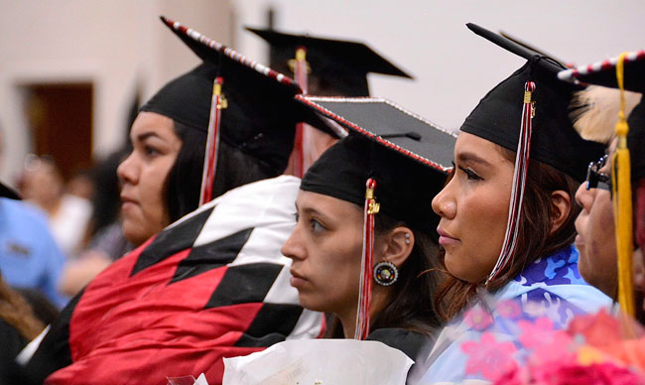
So what are we going to do about it?
Notes:
We have all this information. So this begs the ultimate question: what are we going to do about it? What CAN we do? We have the drive, the philosophical infrastructure and some of the physical. I have a few proposed recommendations for improving our service to our students and the greater community – some can be achieved now or the very near future with help from our community, but to achieve real change and real positive impact, we need more. And I will get to that.

Slide 11
01
Increase
Visibility
We can’t reach poeple if they don’t know or understand the library and its resources exist
Notes:
Our first, and simplest, plan we can put into motion is increasing the library’s visibility. We can’t reach people if they don’t know or understand the library and its resources exist. And this means much more than just telling people there is a library.

Slide 12
Word of Mouth
Simple Marketing
Encourage staff, students, and other users to highlight the library whenever relevant.
Intentionality
All programs & services deserve attention and marketing via simple flyers and/or social media
Notes:
In these ways, visibility grows organically throughout the community. We need to meet our users where they are – whether it is at orientations, involvement fairs, classes or out in the community at markets and other public spaces. We are strapped for both time and funding, so in this instance, we are giving our time. Simple marketing campaigns can be done through low-cost flyers and social media posts. Word of mouth is an important tool that allows peers to connect on a micro level through similar needs like “The librarian’s research tips really helped with this paper” or “my kids really enjoyed last week’s storytime.” These are things we might be doing at an unconscious level but we need to be more intentional if we want to increase our visibility. I was recently speaking with a library director whose mother works in the hospital and is the best example - she brings up the library to nearly every patient and connects their needs with services or events at the library. These avenues both leverage and develop the community’s social capital. Peers relate, while other formats connect outliers with information and resources and thus build their information networks.

Slide 13
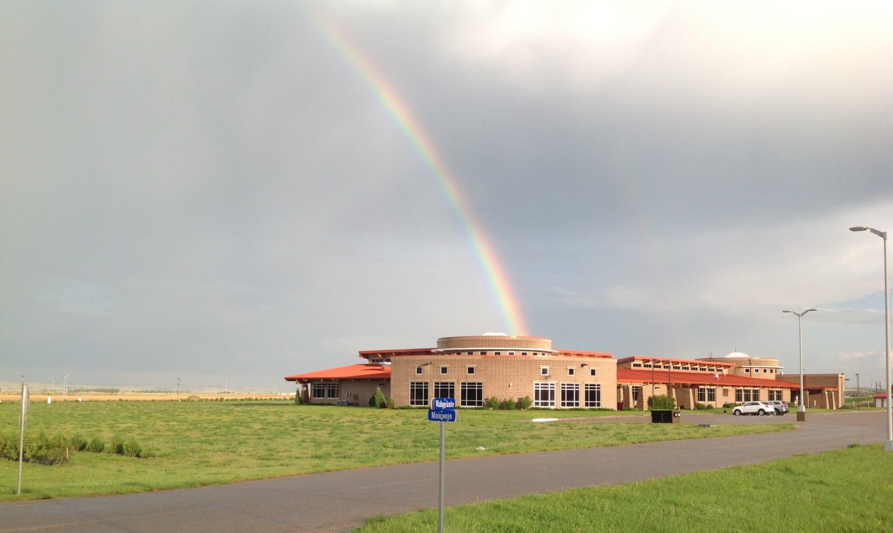
Resolving
Disconnect
Libraries & stereotype
Library & the community
Community & institutions
Notes:
Ultimately, raising visibility with intention means resolving the disconnects within the community. Community members may have misconceptions about libraries, that they are a place to be quiet where there are only books (particularly books that don’t represent the community). They don’t know about the fun, interactive spaces libraries have become where users can find, access, gather, and share information. We need to ensure that if our library staff are – like me, not an original member of the community or even of Native descent – that they are invested in the community and recognizing the community’s unique needs then using that knowledge to inform their work, such as building collections representative of the community, the broader tribes, and even larger Native community. Lastly, increasing and changing our visibility helps change perceptions created by educational colonialization and historic trauma. Apart from generational trauma, institutionalization like boarding schools, are in the recent past – many older community members may remember that time or have undergone cruel whitewashing. They have a distrust of formal and higher education, especially when those spaces are operated by non-natives. We are essentially re-training our community what libraries are and can be: anything the community needs or wants it to be.

Slide 14
“Native culture lives, breathes, and thrives at tribal colleges.” -Robin Máxkii
From “Why I Attended Tribal College,” The Chronicle of Higher Education

Slide 15
Advocacy
02
Promoting and defending services and resources
Notes:
Increasing visibility inevitably leads to advocacy. It isn’t just about the information, the access, the connection, we also need to focus on how we are sustaining these initiatives. We want the community to come inside, have great experiences and share them with others, but we also want them to support us and ensure that we safeguard this, dare I say precious, access point and keep it progressing forward for future generations. As I am doing today, now for you all, we need to advocate to our stakeholders be it university administration, the Board, the Tribal Council, and grant organizations alike, for the great things we are and could be doing to our community. Which leads me to my next recommendation.

Slide 16
03
Funding
Notes:
Everyone’s favorite topic. The truth is, we are a very small library with small amount of staff for the community (the full community) that we serve. We cross-train, wear multiple hats and do the best we can. While we attempt grantwriting, we extend the same amount of effort and time on a $500 proposal as a $50,000 one, which leaves little time for other responsibilities. As most of you likely know, as sovereign nations on federal trust territories, states are not obligated to support us as they do mainstream community or state colleges, such as utilizing property tax revenue. As nonpublic institutions (in name only), we are not allocated public funds as public libraries are. And understandably, college allocations from tuition, etc. should only cover the tools and resources the enrolled students rely on for their studies.

Slide 17
Funding Recommendations
Additional staff member
More study room(s)
Dedicated children's area
Notes:
In order to better serve our entire community, we recommend the Board review budget structures and we seek additional funding to cover our wishlist items that would greatly assist our staff and budget that is already stretched thin. Our recommendations are as follows. To hire an additional staff member which would alleviate the mental, physical, and emotional toll of current staff and provide better capacities for instruction, management, or one-on-one support to users as well as enable the library to have better hours that match the community’s needs. We also recommend the Board supports funding for additional study rooms and a dedicated children's area. More space would allow greater flexibility for our users whether they need to seek out quieter spaces or areas specific for gathering. Quiet spaces would support tutoring sessions or solo studying. More main area space would then give us more spaces to develop our partnerships with on or off-campus resources for programming and provide areas for the community to interact. Additional space would support our initiative to provide safe, welcoming, and free spaces for the community.

Slide 18
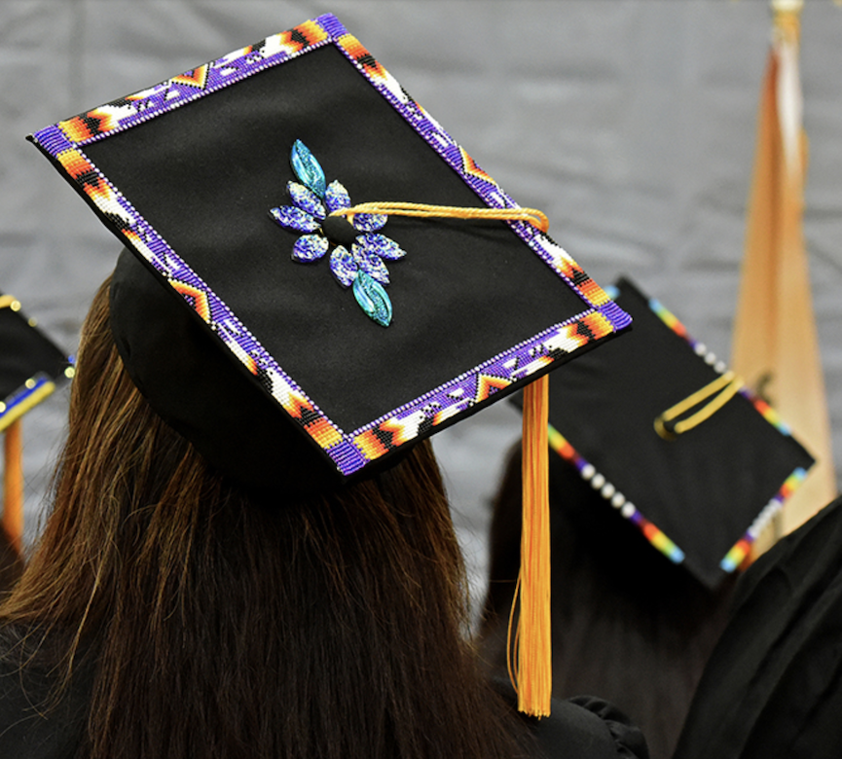
THANK
YOU
Notes:
Thank you very much for your time and consideration of our recommendations to support the library and sustain our community.

Slide 19
Bibliography
Annual Data Factbook, 2018-2019. July, 2019). Retrieved from https://fdltcc.edu/wp-lib/wp-content/uploads/2019/08/FDLTCC-Data-Book-6-22-2019.pdf
Bradbury, B. (2009). Introduction. In B. Bradbury (Ed.), Comprehensive Study of
Education and Related Services on the White Earth Indian Reservation Phase I. Retrieved from http://web.mnstate.edu/bradbury/WE Preliminary Report Phase I.pdf
Cooper, Danielle et al. 2019. When Research Is Relational: Supporting the Research
Practices of Indigenous Studies Scholars. http://sr.ithaka.org/?p=311240 (October 29, 2019).
Dilevko, Juris, and Lisa Gottlieb. 2004. “Working at Tribal College and University Libraries: A Portrait.” Library and Information Science Research 26(1): 44–72.
Home: Fond du Lac Tribal & Community College: MN. (n.d.). Retrieved from https://fdltcc.edu/.
Institutional Research and Data. (n.d.) Retrieved from https://www.rlnc.education/institutional-research
Jackson, A. P., Smith, S. A., & Hill, C. L. (2003). Academic Persistence Among Native American College Students. Journal of College Student Development, 44(4), 548–565. doi: 10.1353/csd.2003.0039
Johnson, R. (2013, July 31). Defending tribal colleges: Administrators, students say low graduation rate due to unique challenges. The Bemidji Pioneer. Retrieved from https://www.bemidjipioneer.com/news/1501472-defending-tribal-colleges-administrators-students-say-low-graduation-rate-due

Slide 20
Bibliography
Keith, J. F., Stastny, S. N., & Brunt, A. (2016). Barriers and Strategies for Success for American Indian College Students: A Review. Journal of College Student Development, 57(6), 698–714. doi: 10.1353/csd.2016.0069
LaFromboise, Aaron. (2019, December 5). Personal interview.
Littletree, Sandra D. 2018. ProQuest Dissertations and Theses “‘Let Me Tell You about Indian Libraries’: Self-Determination, Leadership, and Vision: The Basis of Tribal Library Development in the United States.” University of Washington.
LLTC Assessment Newsletter. (September, 2019). Retrieved from
https://www.lltc.edu/wp-content/uploads/2019/10/Assessment-Newsletter-Sep-19_issue3.pdf
Sorrell, Rhiannon. 2019. “From JSTOR to Jiní: Incorporating Traditional Knowledge in Teaching Information Literacy at Tribal Colleges.” Tribal College. https://tribalcollegejournal.org/from-jstor-to-jini-incorporating-traditional-knowledge-in-teaching-information-literacy-at-tribal-colleges/ (October 29, 2019).
Tribal College Research and Database Initiative. (1999). Tribal Colleges: An Introduction. Alexandria, VA. Retrieved from http://www.aihec.org/who-we-serve/docs/TCU_intro.pdf.
Tribal Colleges and Universities. (n.d.). Retrieved from
https://sites.ed.gov/whiaiane/tribes-tcus/tribal-colleges-and-universities/.
WETCC Student Outcome Data. (n.d.) Retrieved from
https://www.wetcc.edu/achievement--outcomes.html

Slide 21
Image Credits in order of appearance
Illustration by Sam Kaida, courtesy of The Chronicle of Higher Education. Retrieved from https://www.chronicle.com/article/Why-I-Attended-Tribal-College/241161
Fon du Lac Tribal and Community College, courtesy of FDLTCC Facebook. Retrieved from https://www.facebook.com/fdltcc/
Red Lake Nation College, courtesy of the Red Lake Nation. Retrieved from http://www.redlakenation.org/
UTTC Graduates, courtesy of Tribal College Journal. Retrieved from https://tribalcollegejournal.org/uttc-honors-spring-2017-graduates/
Sitting Bull College Library, courtesy of Tribal Library Stories tumblr. Retrieved from https://triballibrarystories.tumblr.com/post/159837127071/mark-holman-sitting-bull-college-library
Leech Lake Tribal College Graduate, courtesy of LLTC. Retrieved from https://www.lltc.edu/

Slide 22
Design Credits
Presentation template by Slidesgo
Icons by Flaticon
Infographics by Freepik
Images created by Freepik
Author introduction slide photo created by Freepik
Text & Image slide photo created by Freepik.com

